Slide 1


Slide 2

The Current State of Resting State Literature
Cameron Craddock, PhD
August 30, 2012

Slide 4





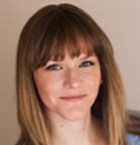
CMI Librarian
Mike Milham, PhD, MD
Ayesha Anwar
Sam Barberie
Caitlin Hinz
Michelle Kaplan, LMSW
Anna Rachlin

Slide 5
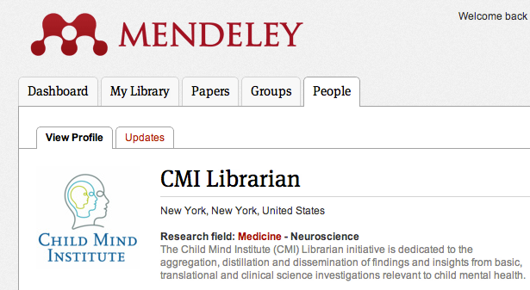
CMI Librarian
http://www.mendeley.com/profiles/cmi-librarian/
Free, online, hand-curated index of literature:
Resting State fMRI
Diffusion Tensor Imaging
Parent-Child Interaction Therapy
Selective Mutism

Slide 6
Index of R-fMRI Literature
CMI Librarian indexes are updated monthly
PubMed searches are run continuously using Sente Reference Management software:
“resting state fMRI” OR “intrinsic functional connectivity” OR “rest AND functional connectivity” OR “fmri AND default mode network”
Search results are hand curated to remove:
Duplicates
Papers not explicitly on fMRI and “resting state” or “functional connectivity”
Papers not in English unless the abstract is in English and provides enough information for vetting

Slide 7
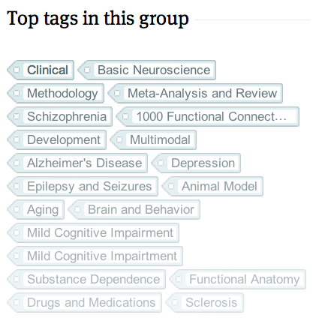
Literature Tags
Clinical – clinical population of any kind, tagged with specific disorder/population
Review/meta-analysis
Methodology – mainly focused on a particular analytical or imaging technique
Basic neuroscience
Brain and behavior
Functional anatomy
Multimodal
Animal Model
1000 Functional Connectomes
Genetics

Slide 8
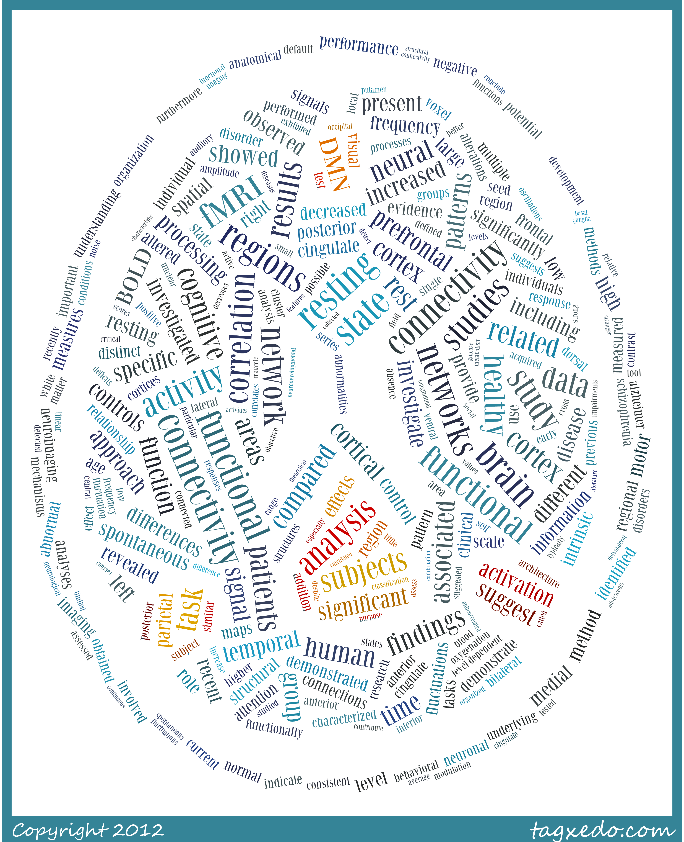

Bibliometric Analysis of Resting State fMRI Literature
Matt Doherty, MSc
CMI Endeavor Scholar

Slide 9
Publication Rate
Before 2005 29%
After 2005 18%
Before 2005 33%
After 2005 47%

Slide 10
Journals
Top 20 journals account for 58% of R-fMRI literature
2 Neuroimaging – 26%
11 Neuroscience – 18%
2 General Science – 9%
4 General Imaging – 4%
1 Clinical – 1%

Slide 11
Citation Connectivity Graph
Small world network statistics
Clustering coefficient
Average path length

Slide 12
Keywords
High term frequency &
low document frequency ->
High term frequency ->

Slide 13
Most Influential Papers by Citation Pagerank
Larger font for titles,
taller graph, smaller bars

Slide 14
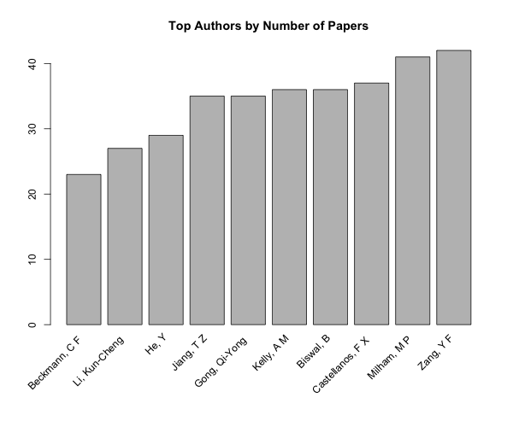
Most Influential Authors
Top by citations
Groups with names sorted by pub count
Names in bigger font

Slide 15
Coming Soon - Methods Oracle
The methods employed in literature are often overlooked in data basing and meta-analysis efforts
Methods sections/papers provide extremely valuable information:
“Poll” researchers in the field about commonly used techniques as well as parameters
Identify open areas for future methods research
Provide additional context for evaluating variance in results for meta-analyses

Slide 16


Slide 17


